Slide 1



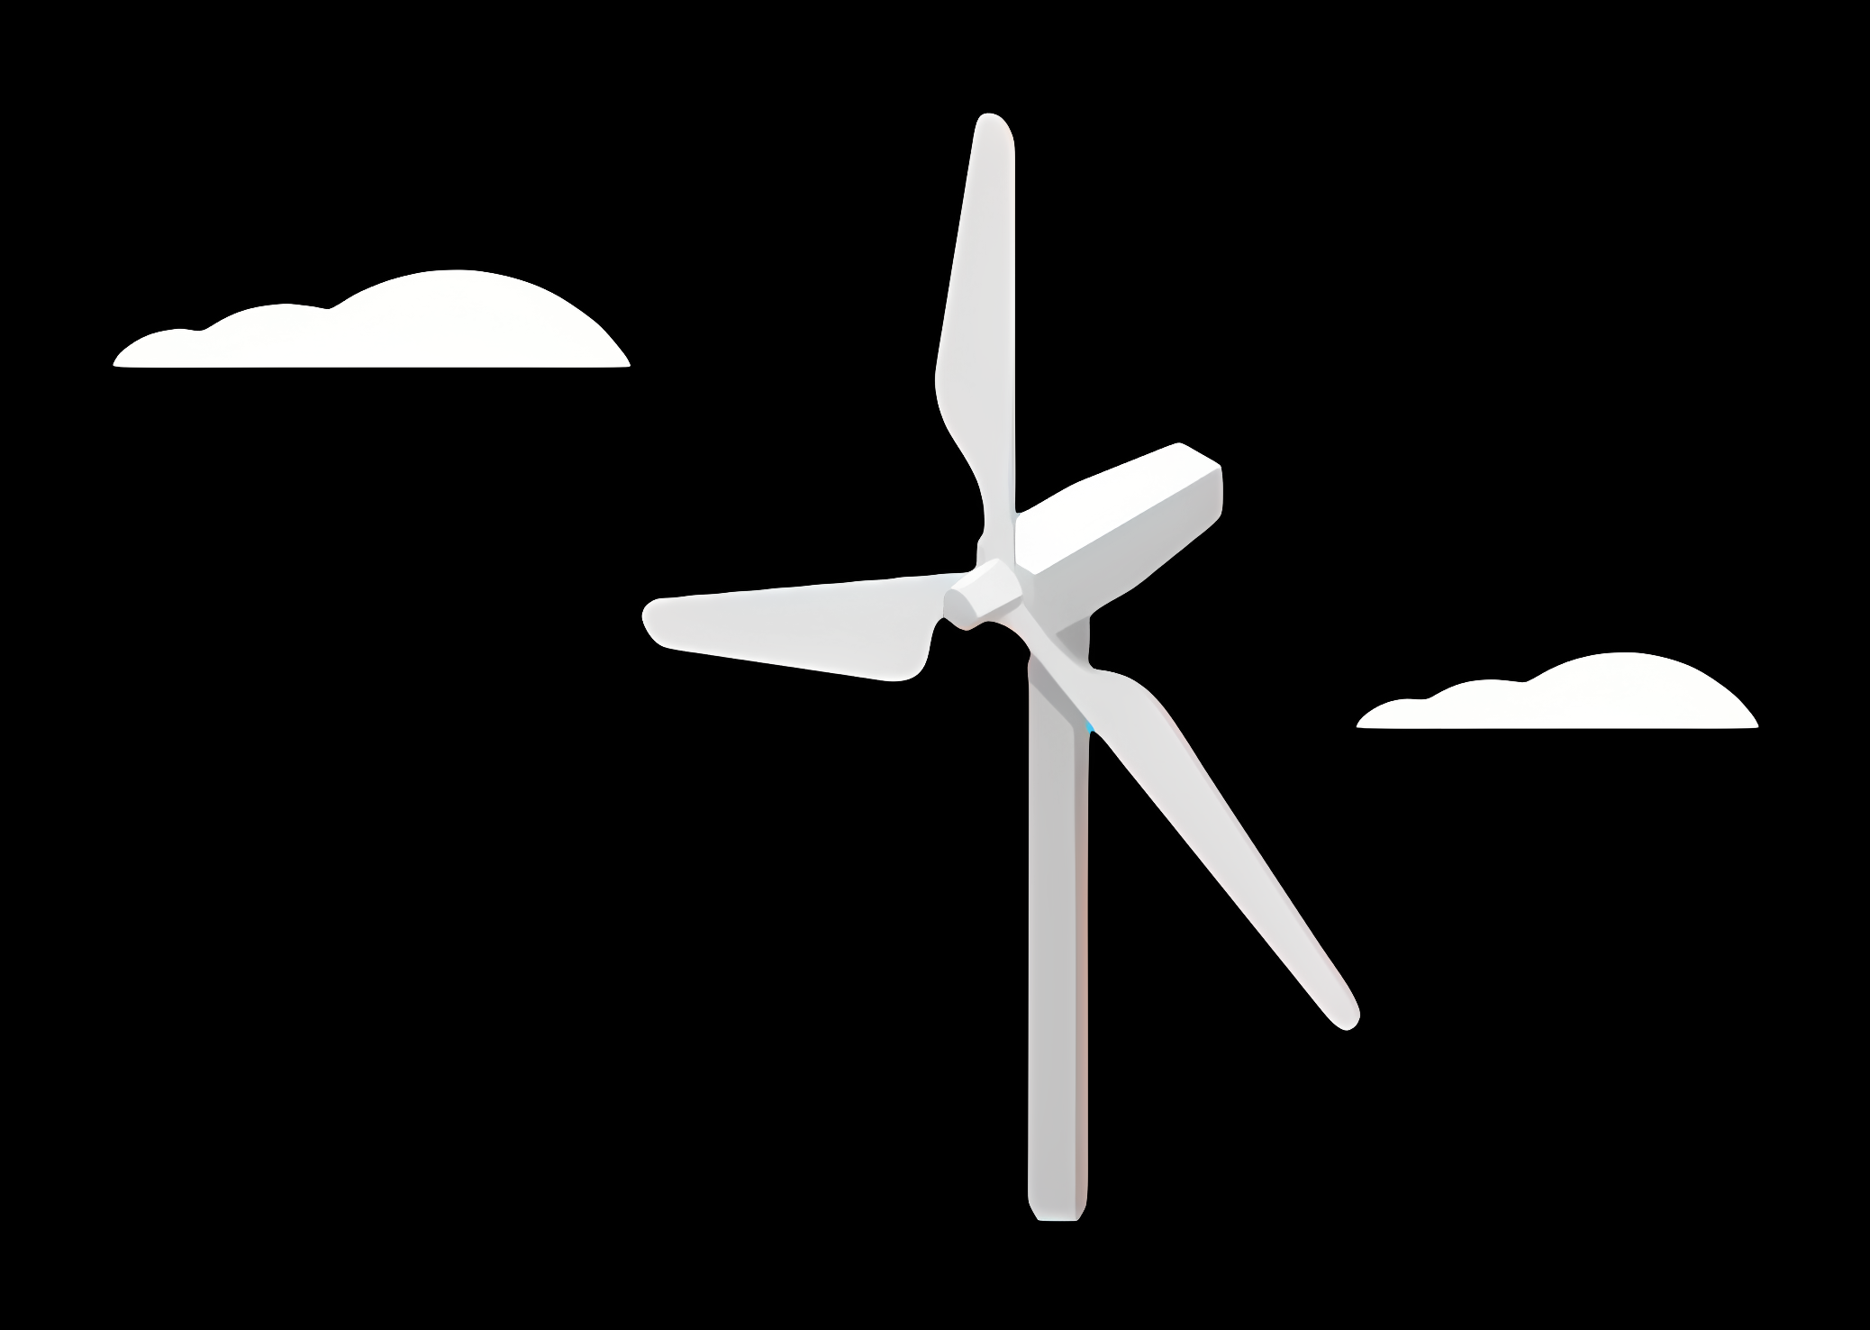
Weekly report: Project management
Week number: 02
Date: 30/09/2025
Supervisor: Prof. Dr.-Ing. David Schlipf
Group members: Mirza Dincer, Saurabh Pankaj Jha

Slide 2
List of Contents
Tasks of the week
What is setpoint smoother?
Results
Mirza Dincer, Saurabh Pankaj Jha

Slide 3
Tasks of the week
Current Simulations: Below to above rated wind speed with IEA 3.4 MW
Region 2.5: 9.3 m/s
Rated Wind Speed: 9.8 m/s [1]
Next Week Plan
Run IEA 3.4 MW turbine model
Test two control configurations:-
Feedback control (LAC off)
Feedback Feedforward (LAC on)
Use ROSCO 2.6 controller
Compare performance between configs
Mirza Dincer, Saurabh Pankaj Jha

Slide 4
What is Setpoint Smoother?
A setpoint smoother is a control technique used in wind turbine controllers to ensure smooth transitions between control region two and three. [2]
This prevents oscillations and instability during transitions near rated wind speed.
Essential for smooth operation in varying wind conditions and widely used in modern wind turbine controllers like ROSCO and COFLEX.
Mirza Dincer, Saurabh Pankaj Jha

Slide 5
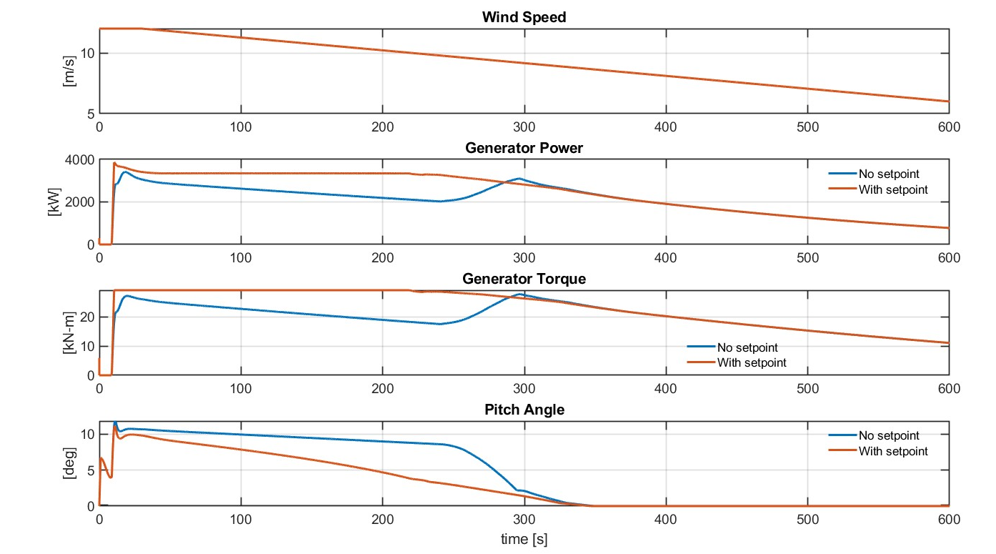
Results
Mirza Dincer, Saurabh Pankaj Jha

Slide 6
Bibliography – Feedback Controller
[1] P. Bortolotti et al., “IEA Wind TCP Task 37: Systems Engineering in Wind Energy - WP2.1 Reference Wind Turbines,” OSTI OAI (U.S. Department of Energy Office of Scientific and Technical Information), May 2019, doi: https://doi.org/10.2172/1529216.
[2] N. J. Abbas, D. S. Zalkind, L. Pao, and A. Wright, “A reference open-source controller for fixed and floating offshore wind turbines,” Wind Energy Science, vol. 7, no. 1, pp. 53–73, Jan. 2022, doi: https://doi.org/10.5194/wes-7-53-2022.
Mirza Dincer, Saurabh Pankaj Jha

